Slide 1
RT6M-01-2019 (GRADE 4-9):SUPPLY,DELIVERY AND OFFLOADING OF MATHEMATICS LEARNING MATERIAL, CONSUMABLES, APPARATUS AND EQUIPMENT TO SCHOOLS FOR THE DEPARTMENT OF BASIC EDUCATION FOR THE PERIOD ENDING 30 NOVEMBER 2023
PRESENTED BY:
NAME : LEBOGANG
SURNAME : MOSUWE
Title: DEPUTY DIRECTOR : TRANSVERSAL CONTRACTING
Date: 6 DECEMBER 2021
Non-Compulsory Briefing Session Presentation

Slide 2
RT6M-01-2019 (GRADE 4-9) : SUPPLY, DELIVERY AND OFFLOADING OF MATHEMATICS LEARNING MATERIAL, CONSUMABLES, APPARATUS AND EQUIPMENT TO SCHOOLS FOR THE DEPARTMENT OF BASIC EDUCATION
AGENDA
1. Opening, welcome and introductions
2. Purpose of the RFP
3. Duration of the Contract
4. Bid Timelines
How to access the Tender Document
Submission of bids
7. Scope of Work
8. Evaluation Criteria
9. Question and Answers

Slide 3
RT6M-01-2019 (GRADE 4-9) : SUPPLY, DELIVERY AND OFFLOADING OF MATHEMATICS LEARNING MATERIAL, CONSUMABLES, APPARATUS AND EQUIPMENT TO SCHOOLS FOR THE DEPARTMENT OF BASIC EDUCATION
1. Opening and Welcome
2. Purpose of the RFP
The purpose of the RFP is to solicit tenders from interested parties (“Respondents”) to enable National Treasury to appoint suitably qualified bidders for the supply and delivery of mathematics learning material.
RFP consists of the SCC, GCC, Pricing Schedule and all other SBDs.
To obtain market related Price and to ensure that Government benefits from the economic of scale
Duration of Contract
End 30 November 2023

Slide 4
4. Bid Timelines

Slide 5
4. Bid Timelines

Slide 6
5. How to access the Tender Document
Bid documents can be obtained from:
National Treasury website under the below link:
http://www.treasury.gov.za/divisions/ocpo/ostb/CurrentTenders.aspx
and eTenders Portal.

Slide 7
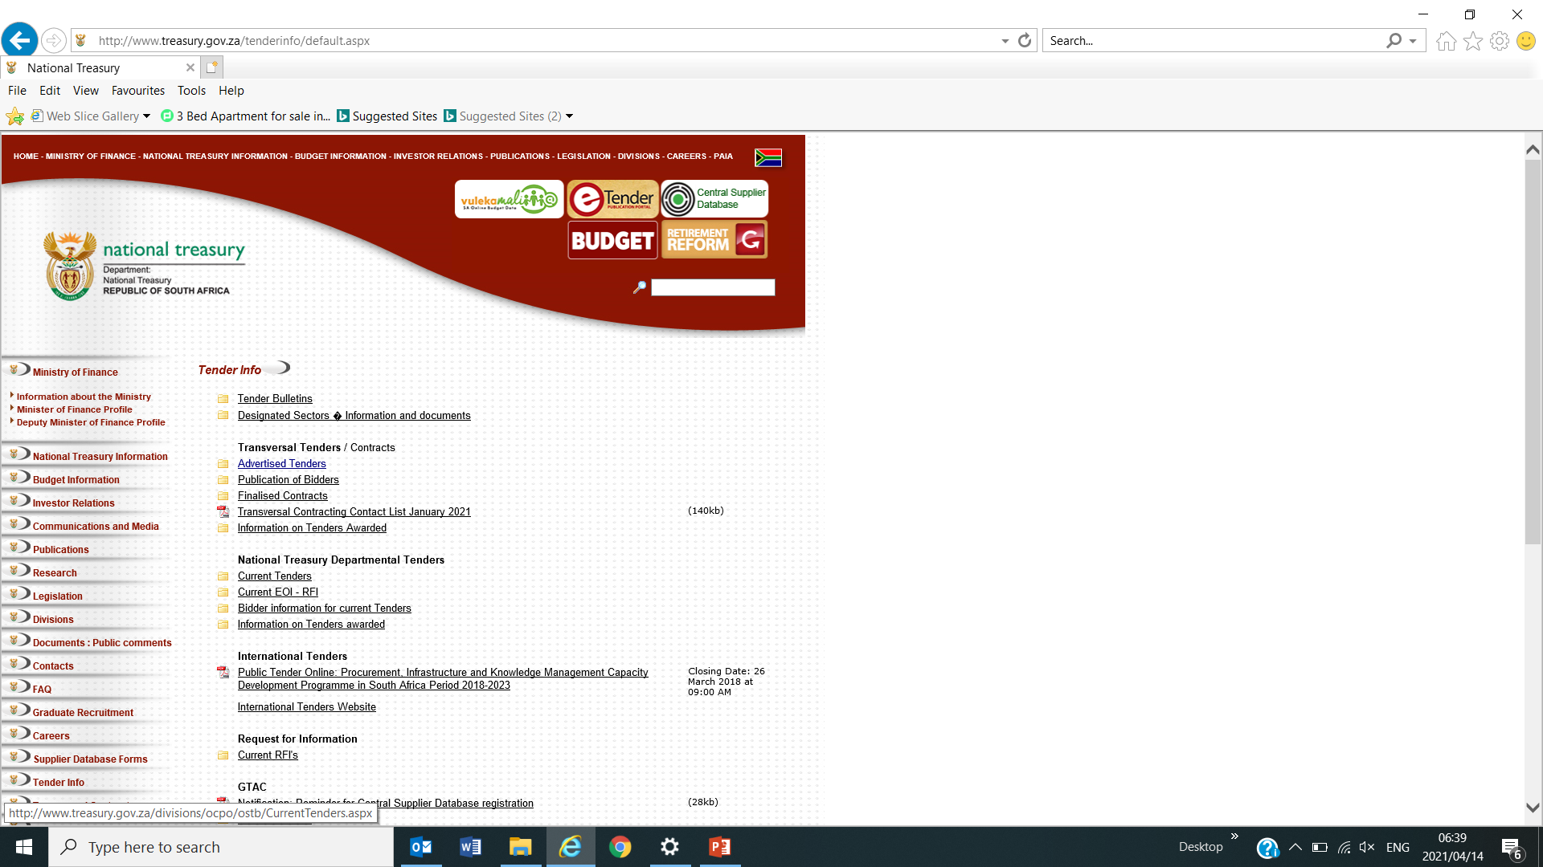
5. How to access the Tender Document

Slide 8
5. Submission of bids
Bidders must submit the bid to TIC in the following format:
One (1) original hard copy clearly marked as “original”;
One (1) memory stick or USB with all the documents on the original hard copy and a soft copy of the pricing schedule to the National Treasury (NT)): TIC by the closing date and time of the bid.
Bidders must ensure that the USB is properly secured

Slide 9
5. Submission of bids
Bids MUST be delivered at the following physical address:
Tender Information Centre (TIC), Ground Floor
National Treasury
240 Madiba Street
Pretoria
0001
NOTE: Bid documents MUST be deposited in the tender box.

Slide 10
7. Scope of Work
Supply, deliver and offload learning material, consumables and apparatus to schools for the Departments of Basic Education Provincially.
Ensure that the mathematics materials are in accordance with relevant specifications and purchase order/s and or instructions received from Provincial Education Departments.
Prepare necessary documentation for delivery of mathematics materials to relevant schools.
Ensure that mathematics materials are delivered at the correct school/s address in proper condition, in correct quantities, signed for by the correct school representative with proof of receipt and school stamp.
Proof of delivery documentation must be submitted together with invoices as proof that the mathematics material was/were received by the correct school in good condition and quantities.

Slide 11
8. Evaluation Criteria
Phase I | Phase II | Phase III | Phase IV
Pre -Qualifying Criteria | Compliance with mandatory and standard bidding requirements | Technical specification compliance | Price and B-BBEE
Compliance with pre-qualification criteria i.e. A bidder who is an EME or QSE | Standard bidding documents must complete and signed. Signed Pricing Schedule Valid Authorisation letter | Compliance to technical requirements (sample submission) | Bids evaluated in terms of the 90/10 preference system

Slide 12
8. Evaluation Criteria
Phase I: Pre- Qualifying Criteria for Preferential Procurement
A bidder who is an EME or QSE
A bidder who is an EME or QSE as per Regulation 4(1)(b) of Preferential Procurement Regulations, 2017.
Bidders are required to complete the preference claim form (SBD 6.1) in full, and submit original and valid B-BBEE status level verification certificates OR originally certified copies thereof OR original and valid sworn affidavit signed by the EME representative and attested by Commissioner of oaths.

Slide 13
8. Evaluation Criteria Phase I: Pre- Qualifying Criteria for Preferential Procurement A bidder who is an EME or QSE
In order to proceed to Phase II, bidders are required to submit proof of the following:
Original valid B-BBEE status level verification certificate OR originally certified copy of the B-BBEE certificate
Original Sworn affidavit signed by the EME representative and attested by a Commissioner of oaths or originally certified copy of a sworn affidavit.

Slide 14
8. Evaluation Criteria Phase I: Pre- Qualifying Criteria for Preferential Procurement A bidder who is an EME or QSE
CIPC B-BBEE certificate : Must either be an original (as per electronic communications Act ) via email or certified copy of the B-BBEE Certificate with the bid document

Slide 15
8. Evaluation Criteria
Phase II: Mandatory and Standard Bidding Documents Requirements
Standard Bidding Documents
The following standard bidding documents must be submitted with the bid at the closing date and time of bid.
SBD 1 – Invitation to bid
SBD 4 – Declaration of interest
SBD 6.1 – Preference Points Claimed (BBBEE)
SBD 8 – Declaration of Past SCM Practices
SBD 9– Certificate of Independent Bid Determination

Slide 16
8. Evaluation Criteria Phase II: Mandatory and Standard Bidding Documents Requirements continues…
Pricing Structure and Schedule
The pricing schedule (see Annexure 1) provided in this bid forms an integral part of the bid document and bidders must ensure that it is completed without changing the structure thereof. All pricing offered must be on a national level.
Bidders can tender on provincial level for each line item and prices quoted must be furnished per line item. The pricing schedule provided in this bid forms an integral part of the bid document and bidders must ensure that it is completed without changing the structure. The prices quoted must be inclusive of all applicable taxes

Slide 17
8. Evaluation Criteria Phase II: Mandatory and Standard Bidding Documents Requirements continues…
Pricing Structure and Schedule
The pricing schedule (Annexure 1) must be sent in an excel format on a USB drive, not as a scanned PDF.
Pricing schedule must be printed, signed and submitted with the bid on the closing date and time of the bid.
Failure to submit the pricing schedule at the closing date and time of the bid will invalidate the bid.

Slide 18
8. Evaluation Criteria Phase II: Mandatory and Standard Bidding Documents Requirements continues…
Authorisation Declaration
All bidders must complete the “Authorisation Declaration” (TCBD 1) in full for all relevant goods or services, sign it and submit it together with the bid response at the closing date and time of the bid invitation.
Any bidders who is sourcing from a Third Party must complete TCBD 1.1 and TCBD 1.2 in full for all relevant goods and/or services. The letter of undertaking from the Third Party must include but not limited to the following:

Slide 19
8. Evaluation Criteria Phase II: Mandatory and Standard Bidding Documents Requirements continues…
Authorisation Declaration
List of item(s) number and item description.
Letter must be on the Third Party letter head, dated and originally signed.
Have the contact’s name, physical and postal address, telephone, and email details and the capacity which a person is signing the letter.
All the information on the letter must be in English.

Slide 20
8. Evaluation Criteria Phase II: Mandatory and Standard Bidding Documents Requirements continues
Authorisation Declaration
The State reserves the right to verify any information supplied by the bidder in the Authorisation Declaration and should the information be found to be false or incorrect, the State will exercise any of the remedies available to it in this bid document.
The bidder must ensure that all financial and supply arrangements for goods or services have been mutually agreed upon between the bidder and the third party. No agreement between the bidder and the third (3rd) party will be binding on the State.
Failure to submit a duly completed and signed Authorisation Declaration, with the required annexure(s), in accordance with the above provisions may invalidate the bid for such goods or services offered.

Slide 21
8. Evaluation Criteria Phase III: Technical Specification Compliance
Samples submission for Visual Screening Evaluation
All items must comply with technical specification as provided in this bid as stated in the technical specification detail of each item. Failure to comply will invalidate the items concerned.
Bidders are required to submit samples for visual screening evaluation for all items offered to verify compliance with technical specifications. Failure to submit the samples as required will invalidate the bid for the items which samples are not submitted.

Slide 22
8. Evaluation Criteria Phase III: Technical Specification Compliance
Sample Submission –
National Treasury will send a schedule indicating a date, time, place, and venue to short listed bidders to submit samples for the evaluation. Bidders’ attention is drawn to the fact that a schedule for sample submission may be forwarded to bidders at a short notice of at least two weeks prior to the date of sample submission.
The request to submit samples may be immediately after the closing date and therefore bidders are required to be ready to submit the samples from the closing date of the bid.

Slide 23
8. Evaluation Criteria Phase III: Technical Specification Compliance
It is a responsibility of the bidder to ensure that correct contact details are provided in the bid document and to ensure that samples are submitted on time, at the correct venue.
Where different sizes of the same item are called for against different item numbers, samples of each size must be submitted.
All samples submitted must be a true representation of the product which will be supplied during the contract period. Must be in the in the original pack and comply to labelling requirements.

Slide 24
8. Evaluation Criteria Phase III: Technical Specification Compliance
All samples must be in original packaging for sample evaluation.
The quantity of samples required for each item is one (1).
Marking of samples to be submitted for Visual Screen Evaluation
Samples must be clearly marked on the outside with the bid number, bid item number, and the bidder’s name. This detail must appear on a label attached to each individual box.
Failure to comply with this condition may invalidate the bid against the relevant item.

Slide 25
Phase III: Technical Specification Compliance
Collection of all samples –
If practical for samples to be collected, bidders will be informed of the date, time, and place where samples may be collected. If samples have not been collected by the bidder after National Treasury have issued a request to bidders to collect the samples, the samples will be disposed of at the discretion of National Treasury.

Slide 26
8. Evaluation Criteria Phase IV: Price and B-BBEE (90/10 Criteria)
Response Field
Bidders are required to submit responsive bids by completing all the prices per line items they are bidding for, mandatory response fields and item questionnaires on the provided pricing schedule for the individual items. In this regard bidders’ attention is drawn to the response field and price structure explanations and examples supplied in the document (TCBD-Response Field).
Applicable Taxes
All bid prices must be inclusive of all applicable taxes.
Failure to comply with this condition will invalidate the bid.
Value Added Tax
All bid prices must be inclusive of fifteen percent (15%) Value Added Tax.
Failure to comply with this condition may invalidate the bid.

Slide 27
8. Evaluation Criteria Phase IV: Price and B-BBEE (90/10 Criteria)
Preference Point System
B-BBEE Status Level of Contributor | Number of Points for the 90/10 system
1 | 10
2 | 9
3 | 6
4 | 5
5 | 4
6 | 3
7 | 2
8 | 1
Non- compliant contributor | 0

Slide 28
RT6M-01-2019 (GRADE 4-9) : SPECIAL CONDITIONS OF CONTRACT
TAX COMPLIANCE
All bidders must be tax compliant at the time of award.
In case of JV/Partnership, all parties must be compliant at the time of award. If one party is not compliant the bid will be disqualified.
Post Award Monitoring and Reporting
National Treasury will conduct meetings with the end users and Suppliers to discuss transversal contracting issues.
Reporting and bidder(s) meetings will be on a quarterly basis and will be scheduled post award.
All successful bidders are required to submit historical value and volume reports via e-mail at the end of each quarterly to: Transversal.Contracting6@treasury.gov.za

Slide 29
9. Question and Answers

Slide 30
RT6M-01-2019 (GRADE 4-9)

